Slide 1

DATA SCIENCE
Class -10
Support Vector Machines

Slide 2
Support Vector Machines

Slide 3
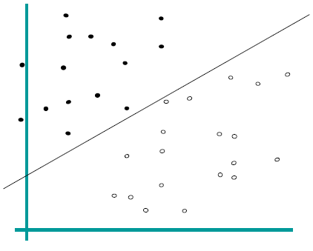
Logistic Regression

Slide 4
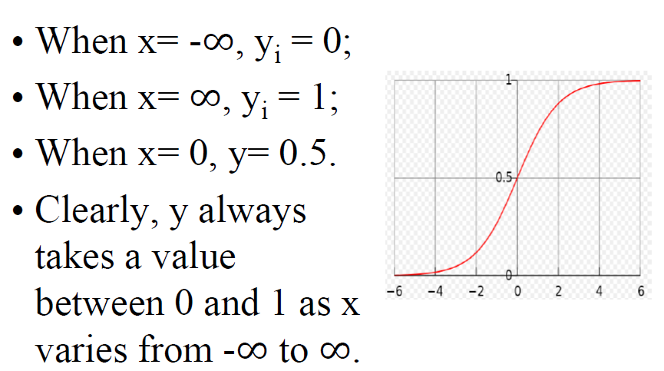
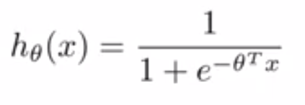
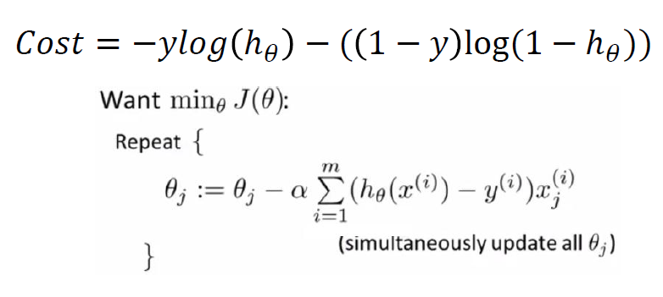
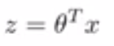
In Logistic Regression…

Slide 5
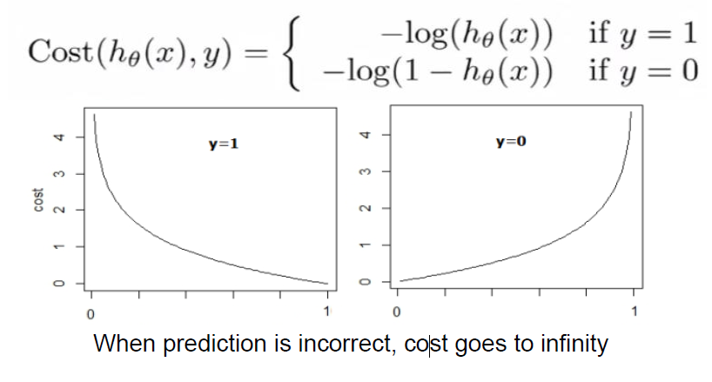
Cost Function – Logistic Loss

Slide 6
Cost Function – Logistic Loss
This is a convex function. And hence Gradient Descent can be applied as follows

Slide 7
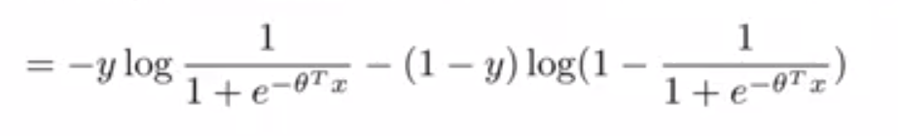
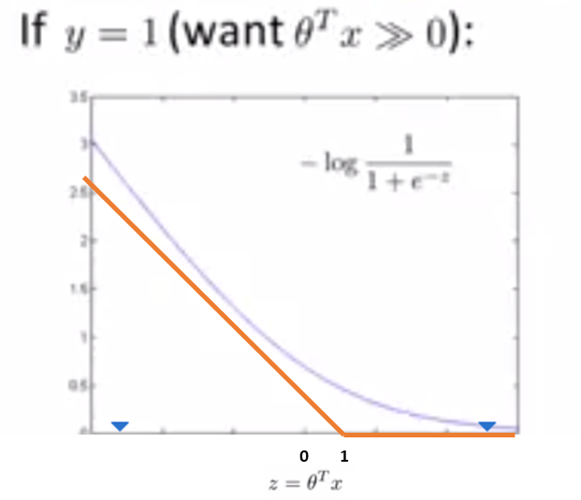
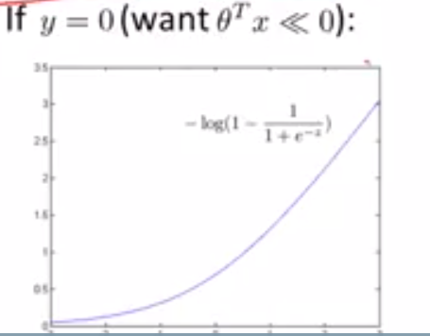
Formulating the Loss Function for SVM – Hinge Loss
HINGE LOSS
Cost1
Cost0
-1 0

Slide 8
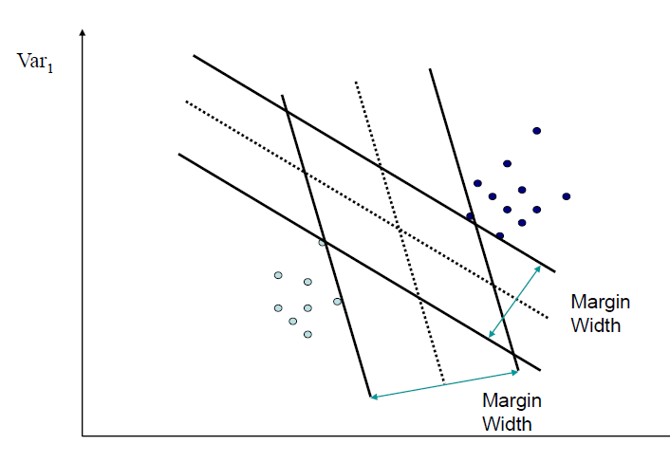
Linear Support Vector Machines
Maximise the margin of Classification
Maximum margin classifier

Slide 9
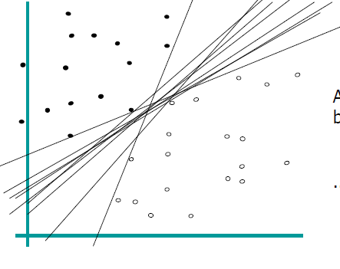
Logistic Regression
Which Classifier is the best?

Slide 10
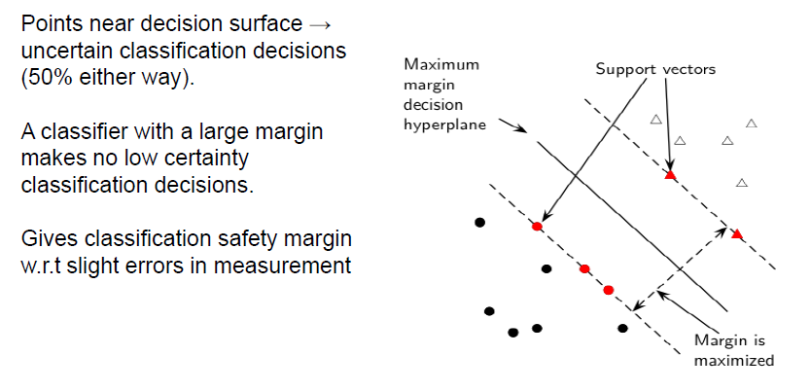
Linear Support Vector Machines – Why Maximize?

Slide 11
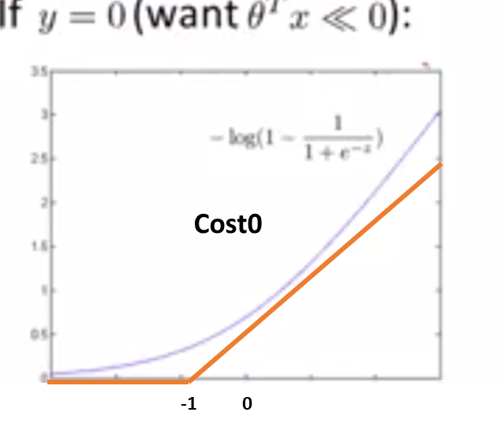

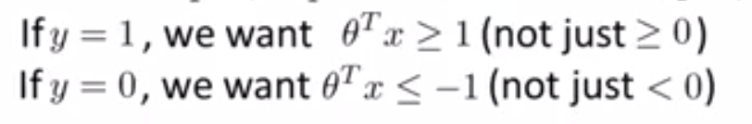
How do we enforce a Large Margin?

Slide 12
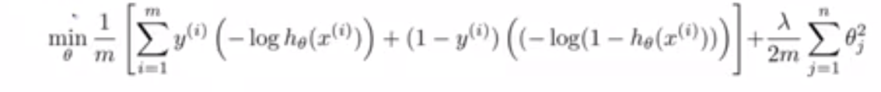
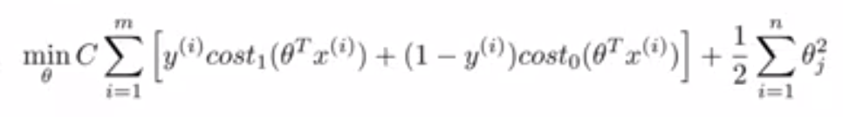
The Cost Function for SVM is similar to Log Reg except for the different Loss Function
Logistic Regression with Regularization
Support Vector Machines

Slide 13
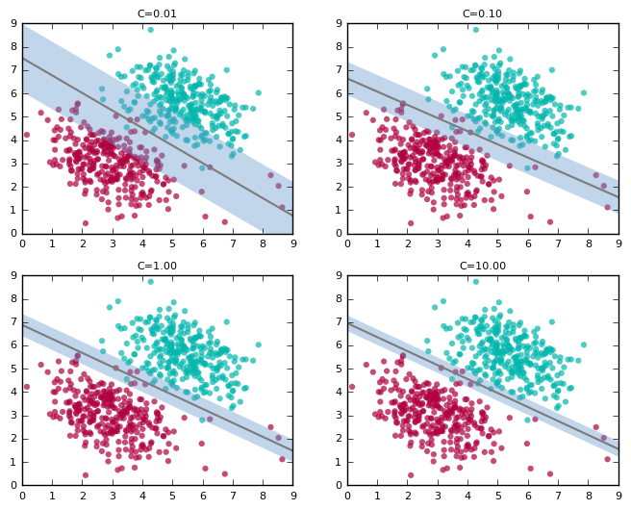
Notion of the Parameter ‘C’
https://blog.statsbot.co/support-vector-machines-tutorial-c1618e635e93 https://www.youtube.com/watch?v=hCOIMkcsm_g&t=650s

Slide 14
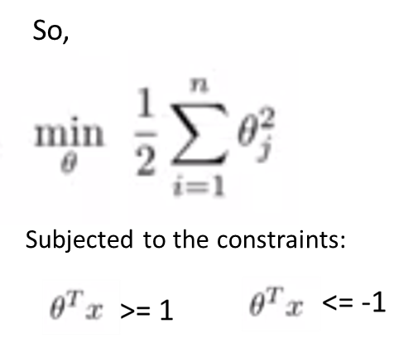
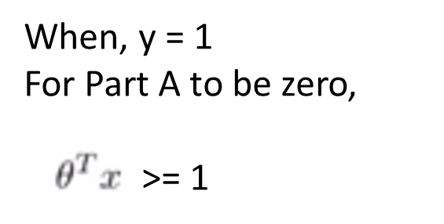
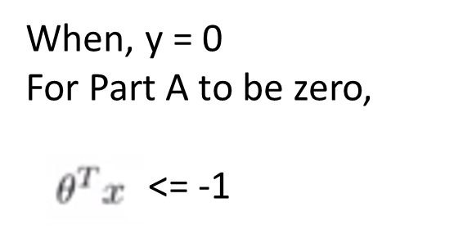
Optimization Problem

Slide 15
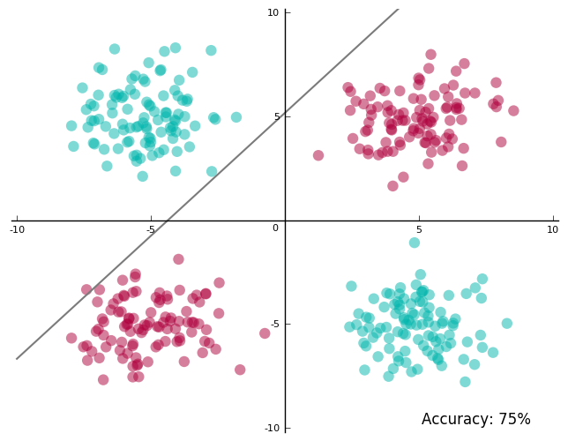
How does SVM fare in such a scenario?

Slide 16
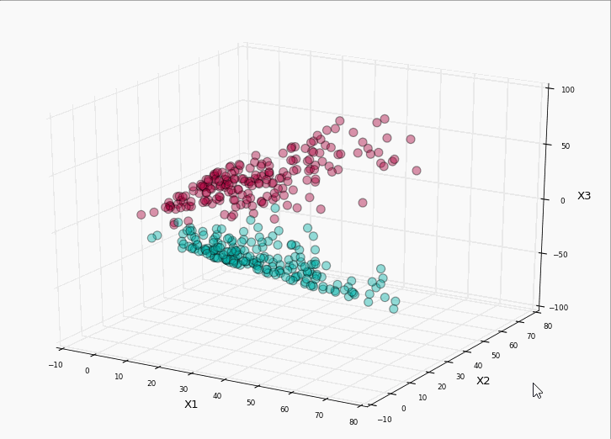
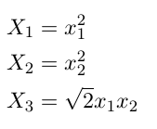
Solution
Create New Dimensions such as the following and project data into these new dimensions

Slide 17
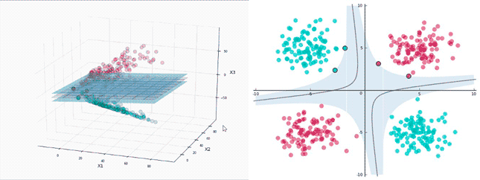
Run SVM on these new dimensions
THIS IS CALLED KERNEL TRICK !!!

Slide 18
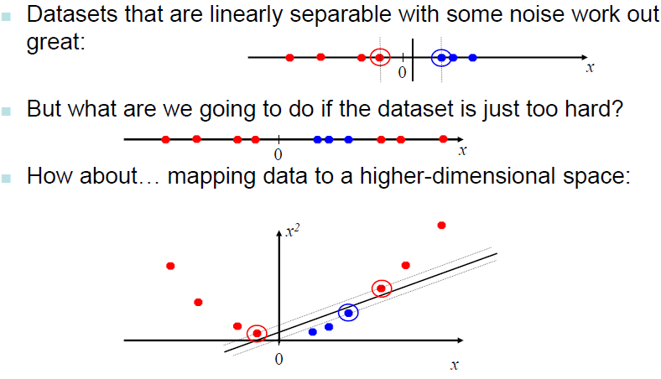
Non Linear SVM

Slide 19
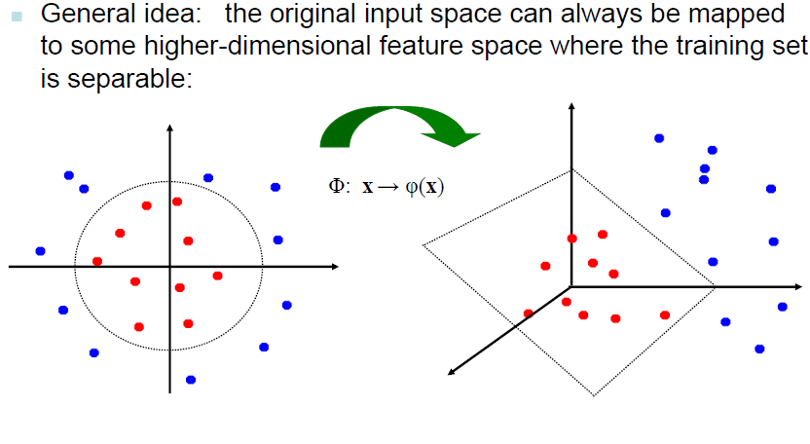
Non Linear SVM

Slide 20
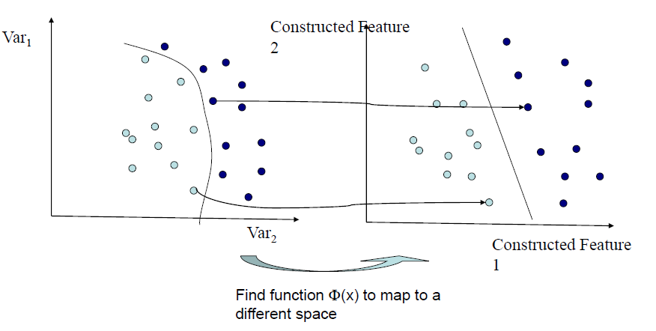
Non Linear SVM

Slide 21
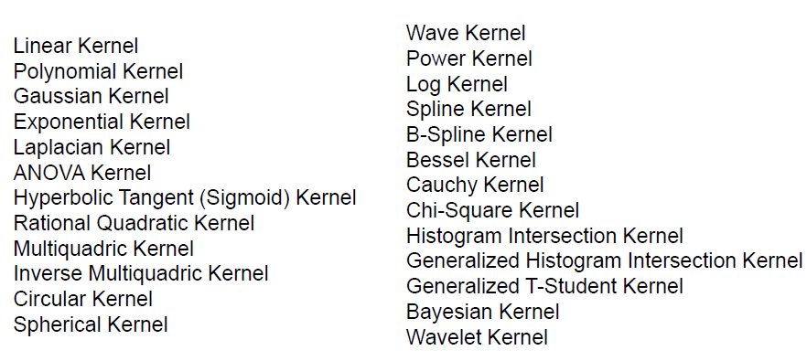
Kernels

Slide 22


